Slide 1







An Analysis of Current Usage and Trends in Technology
Joshua Kalinsky
13/04/2023

Slide 2

TABLE OF CONTENTS
COVER PAGE: 1
OUTLINE: 3
EXECUTIVE SUMMARY: 4
INTRODUCTION: 5
METHODOLOGY: 6
RESULTS: 7-11
DASHBOARD: 12-15
DISCUSSION: 16
OVERALL FINDINGS: 17
CONCLUSION: 18
APPENDIX: 19-21

Slide 3



OUTLINE
Executive Summary
Introduction
Methodology
Results
Visualization – Charts
Dashboard
Discussion
Findings & Implications
Conclusion
Appendix

Slide 4

EXECUTIVE SUMMARY
The following slides explore and analyse key findings and takeaways from data collected as part of the 2019 Stack Overflow Developer Survey, as well as Github Job postings and a Salary Survey.
The analysis provided insights into the following (as at the time data was collected):
Popular programming languages, platforms, databases and developer environments.
Skills gaps and demand in these developer spaces.
Anticipated near-term future trends and developments based on respondents learning demands.
Demographics in aforementioned spaces (for example gender and country gaps)
Current salaries in programming languages (based on a Salary Survey)

Slide 5
INTRODUCTION
About:
Analysis of current popularity and trends in Software Development
Purpose:
Identification of future skill requirements
Identify top programming languages in demand
Identification of technology usage and trends among developers
Top Databases, skills and environments in demand
Audience:
Developers (current and aspiring, HR Professionals, Decision Makers (IT Heads, Business owners), educators and policy makers

Slide 6

METHODOLOGY
Data Source:
2019 Stack Overflow Developer Survey
Job Postings API made by available by Kaggle. Converted to a JSON (wrangled via Python)
Popular Languages (Salary Survey)
Data Wrangling:
Collection of data via API and webscraping on Python.
Duplicates Removal, data imputation and normalisation.
Analysis & Visualization:
Exploratory analysis and data visualization were conducted using various Python libraries such as Beauitful Soup, Matplotlib and Cognos.

Slide 7
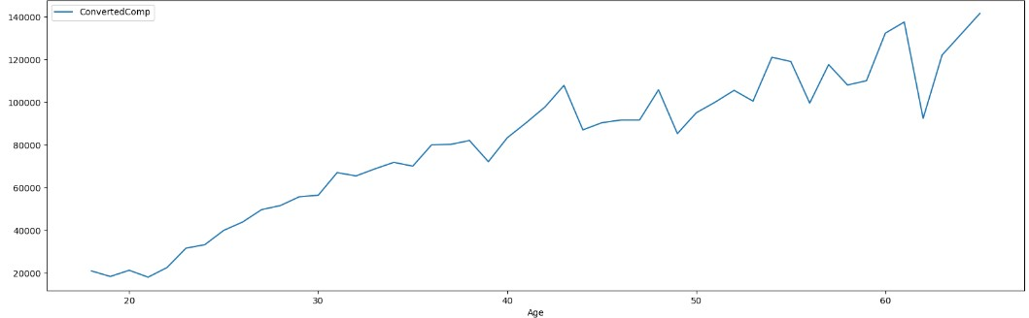
RESULTS: DEMOGRAPHICS AND CONVERTED COMPENSATION
Random sample size was based on N=11,398 respondents.
Median age of respondents was 29.
Median compensation of respondents was $57,745 per annum.
Following removal of 879 compensation outliers, sample size was reduced to n=10,519. Median compensation following removal was $52,704 and mean compensation $59,883.
Median compensation was slightly higher for women respondents following removal of outliers at $54,956 whereas median compensation for men was at $52,339.
There was a positive correlation between compensation and Age at r = 0.4(40%)

Slide 8
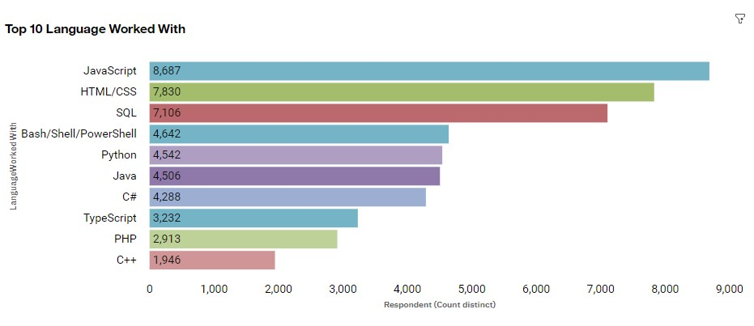
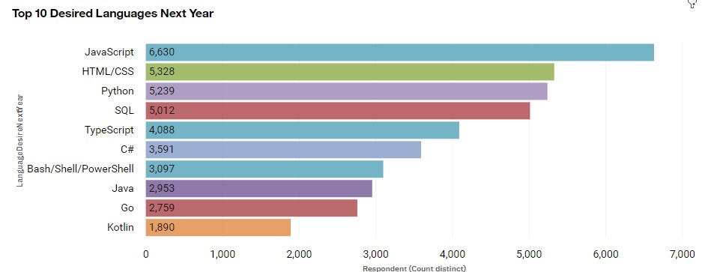
RESULTS:PROGRAMMING LANGUAGE TRENDS
Current Year
Next Year

Slide 9
PROGRAMMING LANGUAGE TRENDS - FINDINGS & IMPLICATIONS
Findings
Javascript and HTML/CSS are most popular in 2019 and remain so in 2020.
SQL was the third most popular in 2019 and learning demand for it remains in 2020. But increasing interest in Python means it may lose this position in the future.
There's increasing interest in Python and Typescript
Interest in Powershell/Bash appears to be declining in the future.
Implications
Web development is in high demand, and Javascript and HTML/CSS remain dominant in the WebDev space —TypeScript may however catch up in the future as interest in it is increasing.
SQL looks set to remain the most popular language for big data storage and database queries
Popularity is increasing in Machine Learning in Artificial intelligence and this is reflected by growing interest in Python

Slide 10
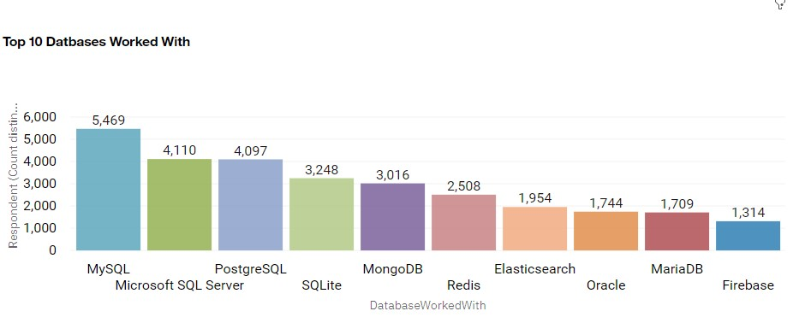
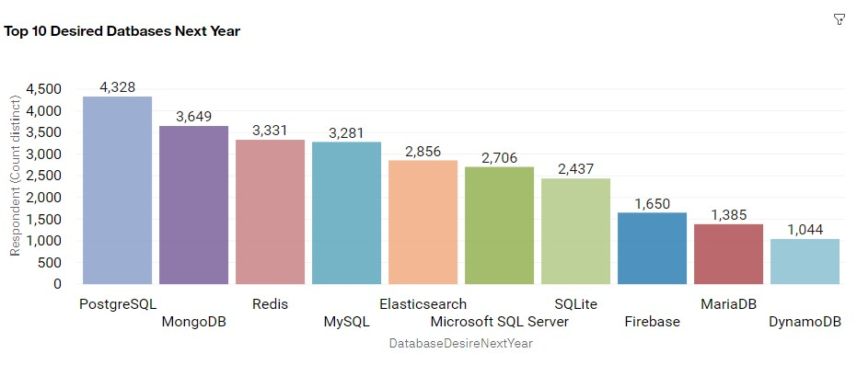
RESULTS: DATABASE TRENDS
Current Year
Next Year

Slide 11
DATABASE TRENDS - FINDINGS & IMPLICATIONS
Findings
SQL database programs are most popular, evidenced by MySQL and MicrosftSQL being most used in 2019.
Demand for PostgreSQL is increasing faster than all other DBs and has most interest amongst respondents in 2020.
Interest in MongoDB, Redis and ElasticSearch are increasing and fast overtaking many currently used DBs.
Implications
There is an increasing preference amongst developers to work in open-source databases
Fast-growing interest in NoSQL databases likely reflects growing demand in dealing with unstructured and semi-structured data. Also reflective of other limitations of relational databases such as scalability
It appears imperative that data analysts develop their expertise in NoSQL databases.

Slide 12

DASHBOARD
https://eu-gb.dataplatform.cloud.ibm.com/dashboards/50e79da2-084d-4639-80a4-f8bf05332502/view/651df66403b60bff49d6cce4079e28527c65270be0bb8b0283867b490d357497a86f10c7c8294953d9150763f1bf105c9d

Slide 13
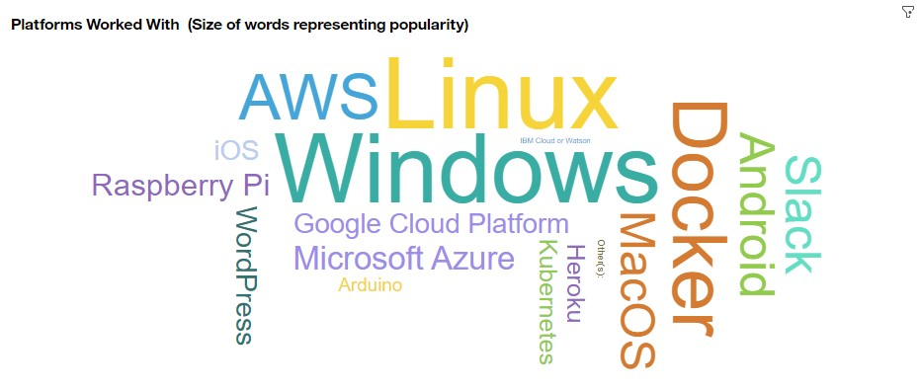
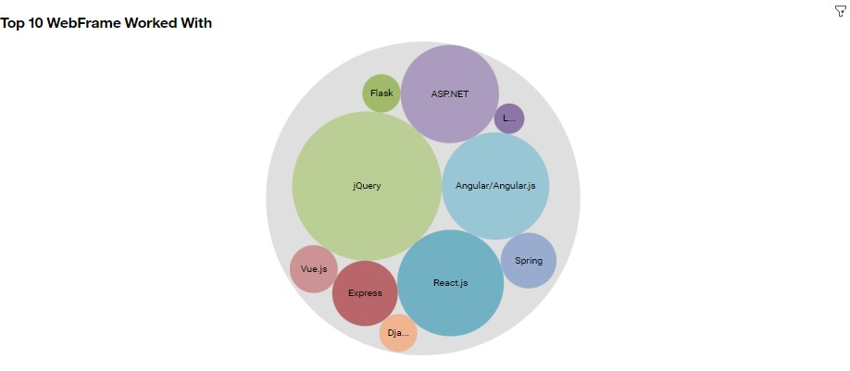
DASHBOARD TAB 1

Slide 14
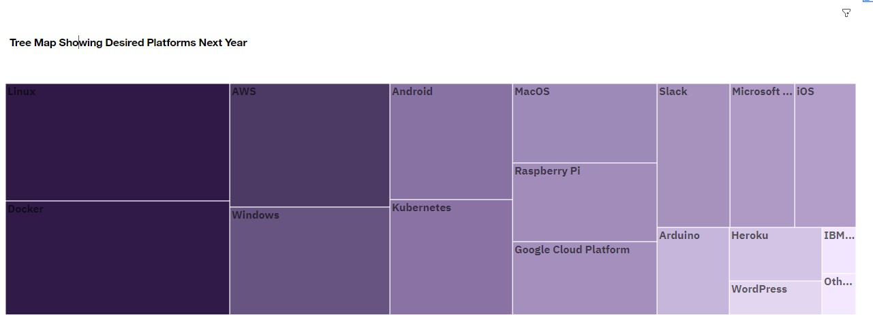
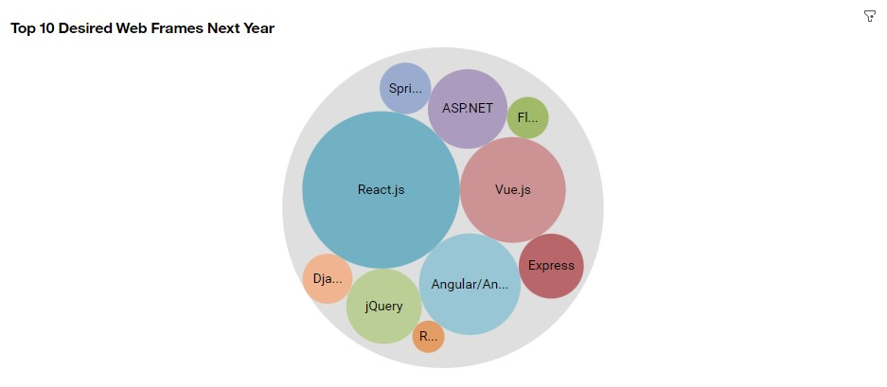
DASHBOARD TAB 2

Slide 15
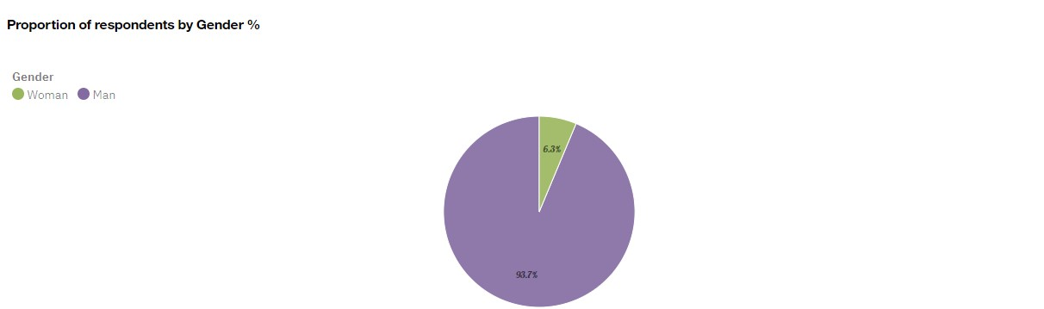
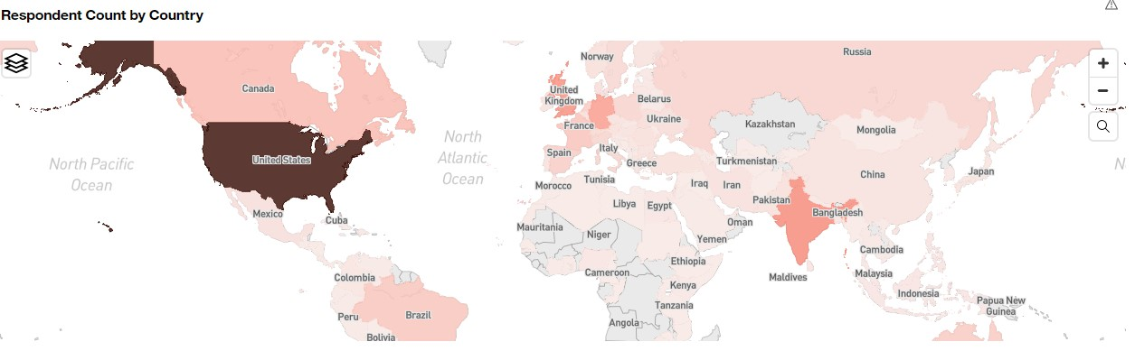
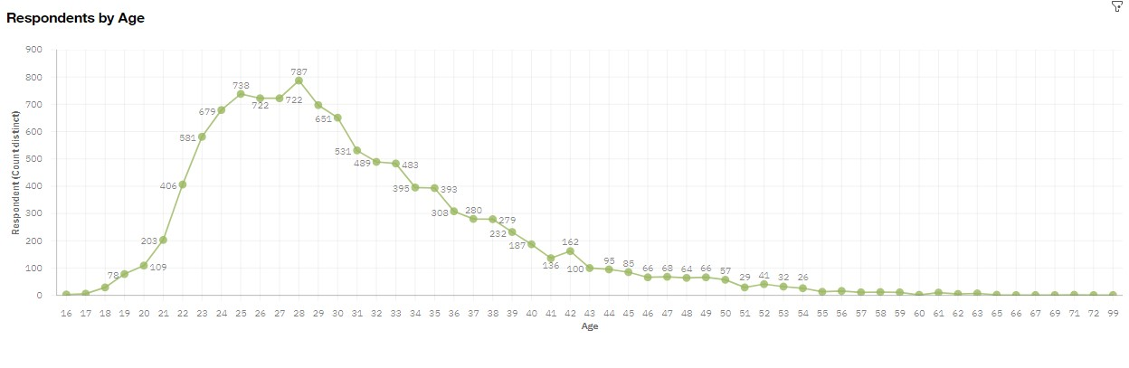
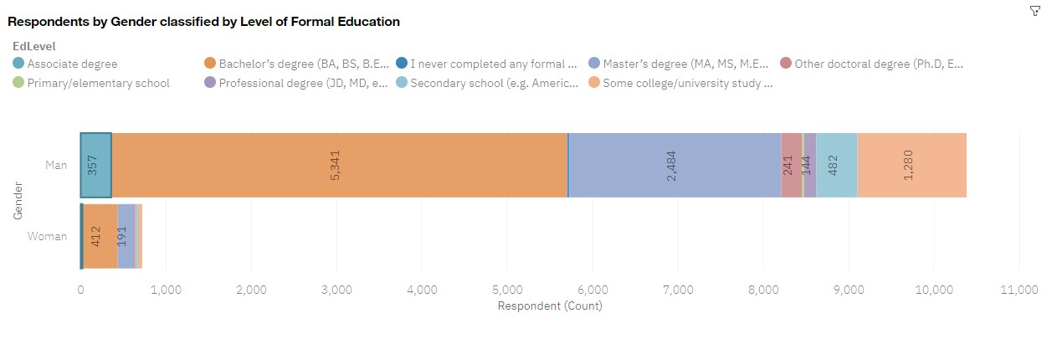
DASHBOARD TAB 3

Slide 16
DISCUSSION
Overall, findings from the analysis provide insights and warrants further discussion of the following:
The languages, databases and platforms that are in demand going forward
Trends in software and infrastructure that businesses, developers, educators, investors and policymakers should focus on.
Which technologies should educators place more emphasis on teaching in upcoming years?
What level of focus/budget and resource businesses and investors should allocate to new infrastructure in line with current data trends, business operational aspects and overall objectives?
What compensation should businesses offer, with respect to certain software skills, in order to ensure they are competitive and attracting the right talent?
What does distribution of annual compensation for developers look like?
What is the developer demographic like? Is there a gender representation gap? How does this affect a workplace and entrants into the market and what opportunities does it present?

Slide 17
OVERALL FINDINGS & IMPLICATIONS
Findings
In 2019 there was a high usage and anticipated interest in 2020 still in Javascript and HTML/CSS. Interest in Typescript is increasing too.
There is increasing interest in Python showing growing demand – N.b On average data professionals using Python and Swift earn higher salaries.
Continued high usage and interest in SQL. MySQL had highest usage in 2019 but interest in PostgreSQL is outstripping it as most desired database program in 2020
Interest in NoSQL databases is growing rapidly with MongoDB and Redis fast overtaking many currently used SQL databases. Indeed interest in these two databases surpassed interest in MySQL in 2020
There appears to be a gender gap in that men represented the majority of respondents. This is perhaps reflected by the fact that once outliers were removed the median wage of women respondents were higher evidencing a need for more women in software.
Implications
Web development is in demand with Javascript and HTML/CSS still most popular. Current and aspiring developers may want to also attain competency in Typescript.
With Machine Learning and AI becoming increasingly prevalent across businesses interest in Python is growing and data professionals are looking to gain competency in this language in 2020. This is reflected in current salary of those using Python.
With the growing need to store and handle big data, data professionals should ensure they are competent in using NoSQL programs.
Businesses will need to adapt to ensure they are focused on relevant and suitable areas. And have allocated budget to talent acquisition & learning development in the right areas.
Policy makers and businesses (both commercial and educational) will need to ensure they are closing the gender gaps through both policy and incentives. This will ensure a more equitable representation of women.

Slide 18

CONCLUSION
A subset of data (N=11,398) from 2019 Stack Overflow Developer Survey (reduced from N=90,000), as well as Job Postings API, made available by Kaggle and Popular Languages (Salary Survey) was analysed.
This provided insights into the most utilised technologies and shifts in future learning demands and requirements by developers currently working in software. Insights into current salary expectations based on developer competencies, correlations between salary and age, as well as the gender make-up of those working in software were also gleaned.
To summarise, there is likely to be a rise of ML and AI requirements in software which is evidenced by the number of respondents looking to obtain competency in Python.
There is also a clear shift to NoSQL databases in response to the changing data landscape with more and more unstructured and semi-structured data needing to be handled.
Policy makers and organisations (including educators) need to address the lack of women working in software in order to make the workforce more representative and versatile. Aspiring females should be encouraged by the fact that there is a demand for their talent as evidenced by a higher median salary than men when outliers are removed, taken together with the gap in representation. The demand may mean they are provided with financial incentives, such as funded courses. Given it is likely educators and businesses will place emphasis on encouraging more women into the software space going forward.

Slide 19
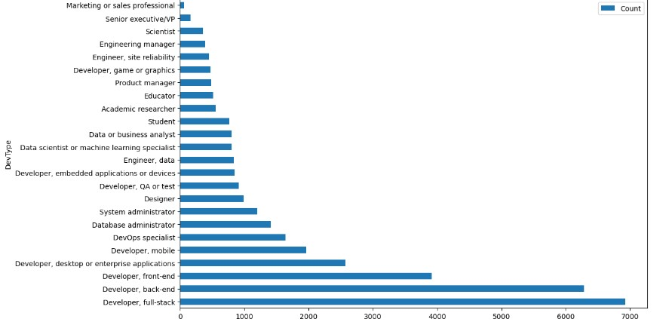

APPENDIX

Slide 20
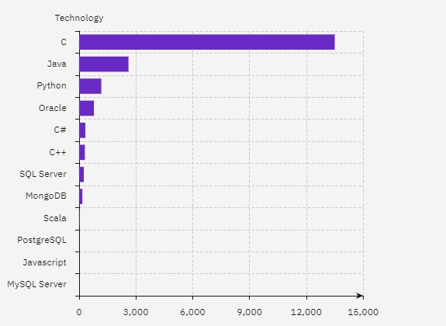
Kaggle API: JOB POSTINGS
N.b This data was retrieved from a modified subset of data originally made available here under a public domain license: https://www.kaggle.com/promptcloud/jobs-on-naukricom
Modified subset found here JSON

Slide 21
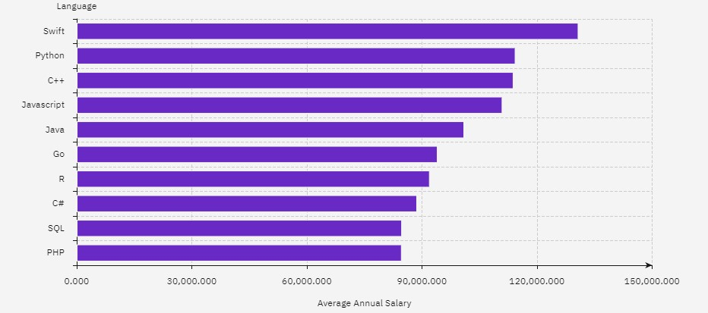
POPULAR LANGUAGES: AVERAGE SALARY
Nb. The figures above are based on survey data regarding popular programming languages provided by IBM. Link: Salary Survey.

